Slide 1
ISPARTA UNIVERSITY OF APPLIED SCIENCES (IUAS)
&
MEVLANA Exchange Program
ISPARTA/ TURKEY

Slide 2
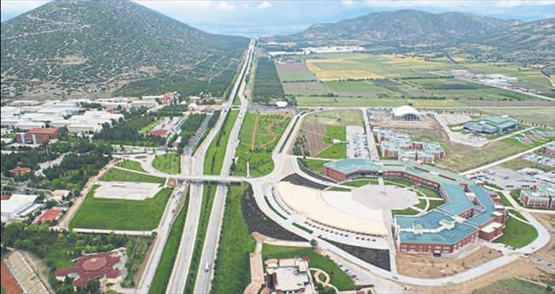
ISPARTA UNIVERSITY OF APPLIED SCIENCES
A new university was established in Isparta under the name of Isparta University of Applied Sciences (IUAS) with “Law No. 7141 on the Amendment of the Law on Higher Education and Some Laws and Decree Laws” which was published in the Official Gazette no. 30425 dated May 18, 2018 and entered into force.
5 Faculties
3 Colleges
17 Vocational Schools
6 Graduate Schools
Nearly 43.000 students and 1700 academic staff.

Slide 3
FACULTIES IN IUAS
Faculty of Agricultural Sciences and Technologies (formerly named as Faculty of Agriculture),
Faculty of Forestry,
Faculty of Technology,
Faculty of Eğirdir Aquaculture
Faculty of Bussiness

Slide 4
ACCOMODATION IN SDU
Incoming students can accomodate in private student apartments, Çiftçi Eğitim Merkezi in Central Campus or in private dormitory.
Incoming academic staff can accomodate in University guest house located in University and city center.
Programme does not pay for the accomodation expenses.
For.More.Information:
http://uluslararasi.sdu.edu.tr/en/external-relations-office/accomodation-5755s.html

Slide 5
WHO IS MEVLANA?
Mevlana has not make any discrimination between people as indicated in his verse “Come, come whoever you are.
UNESCO, due to the 800th anniversary of Mevlana’s birth, declared the year 2007 as Mevlana and Tolerance year.
Mevlana attributed great importance to “change” in his philosophy throughout his life
He is also the author of the important works like Masnavi, Divan-ı Kebir, Fihi Mafih, Mektubat and Mecalis-i Seba.

Slide 6
Mevlana Exchange Programme is a programme which aims the exchange of students and academic staff between the Turkish Higher Education institutions and Higher Education institutions of other countries.
MEVLANA EXCHANGE PROGRAMME

Slide 7
DIFFERENCE WITH OTHER
PROGRAMMES:
Offer the opportunity of studying or teaching in any University in the world.
There isn’t any geographical boundaries.
Opportunity of non-refundable grant.
Mevlana Exchange Programme includes 58 countries.
The participants of Mevlana Exchange programme can also participate in other Exchange programmes.

Slide 8
MEVLANA EXCHANGE PROGRAMME BILATERAL AGREEMENT
A valid bilateral agreement is required for student and academic staff exchange.
The bilateral agreements is valid for five years.
The institutes can make an additional Protocol to indicate the responsibility of foreign universities.
Suleyman Demirel University has 19 bilateral agreements with 11 different countries.
Suleyman Demirel University has 727 incoming students and 427 incoming academic staff quota.
Suleyman Demirel University Mevlana Office and its voluntary students help our incoming students and academic staff.

Slide 9
EXCHANGE OF STUDENTS
The students registered to the following programs of the universities which have bilateral agreement can benefit from Mevlana Exchange Programme
Vocational schools (2nd class)
Bachelor’s degree (2nd, 3rd, 4th classes)
Master, doctorate programme (after the first semester excluding the language or scientific preparation semesters)
Mevlana Değişim Programı Kurum Koordinatörlüğü

Slide 10
EXCHANGE OF STUDENTS
Turkish citizen students who study in foreign university unfortunately couldn’t apply to Mevlana Exchange programme.
Foreign students of Turkish universities couldn’t apply to universities in their countries.
For the offered courses, please visit SDU International Office or Mevlana websites.

Slide 11
CIRCUMSTANCES TO BE A MEVLANA EXCHANGE STUDENT
Grade Point Average (GPA) Should Be At Least:
2.5/4.0 for the students vocational schools and bachelor’s degree
3.0/4.0 for the Ms and PhD students
The score of language of which the host institute use for teaching
Mevlana Exchange Score: : 0.5*Language Score + 0.5* GPA.

Slide 12
24.01.2018 THE COUNCIL OF HIGHER EDUCATION EXECUTIVE COUNCIL DECISIONS It has decided as follows in compliance with the specificied area as student (incoming / outgoing) and academic staff exchange with the countries listed below.
COUNTRY | AREA | COUNTRY | AREA
Afghanistan | Social and Human Sciences | Brazil | Engineering and Physical Sciences
Albania | Social and Human Sciences | Canada | Engineering and Physical Sciences +Health Sciences
Algeria | Social and Human Sciences | China | Engineering and Physical Sciences +Health Sciences
Australia | Engineering and Physical Sciences + Health Sciences | Djibouti | Social and Human Sciences
Azerbaijan | Social and Human Sciences | Egypt | Social and Human Sciences
Bangladesh | Social and Human Sciences | England | Engineering and Physical Sciences +Health Sciences +Social and Human Sciences
Belarus | Engineering and Physical Sciences | France | Engineering and Physical Sciences +Health Sciences +Social and Human Sciences
Bosnia-Herzegovina | Social and Human Sciences

Slide 13
COUNTRY | AREA | COUNTRY | AREA
Gambia | Social and Human Sciences | Mexico | Engineering and Physical Sciences
Georgia | Social and Human Sciences | Mongolia | Social and Human Sciences
India | Engineering and Physical Sciences +Health Sciences +Social and Human Sciences | Montenegro | Engineering and Physical Sciences +Social and Human Sciences
Indonesia | Engineering and Physical Sciences | Morocco | Social and Human Sciences
Iran | Engineering and Physical Sciences | New Zealand | Engineering and Physical Sciences
Iraq | Social and Human Sciences | Oman | Engineering and Physical Sciences +Social and Human Sciences
Japan | Engineering and Physical Sciences +Health Sciences +Social and Human Sciences | Philippines | Engineering and Physical Sciences
Jordan | Social and Human Sciences | Pakistan | Engineering and Physical Sciences
Kazakhstan | Social and Human Sciences | Palestine | Social and Human Sciences
Kyrgyzstan | Social and Human Sciences | Qatar | Engineering and Physical Sciences +Social and Human Sciences
Kosova | Social and Human Sciences | Romania | Social and Human Sciences

Slide 14
COUNTRY | AREA | COUNTRY | AREA
Kuwait | Engineering and Physical Sciences +Social and Human Sciences | Russia | Engineering and Physical Sciences +Social and Human Sciences
Libya | Social and Human Sciences | Saudi Arabia | Engineering and Physical Sciences + Social and Human Sciences
Lebanon | Social and Human Sciences | Singapore | Engineering and Physical Sciences
Macedonia | Social and Human Sciences | South Africa | Engineering and Physical Sciences
Malaysia | Engineering and Physical Sciences +Social and Human Sciences | South Korea | Engineering and Physical Sciences +Health Sciences +Social and Human Sciences
Spain | Engineering and Physical Sciences +Social and Human Sciences | Ukraine | Engineering and Physical Sciences
Sudan | Social and Human Sciences | USA | Engineering and Physical Sciences +Health Sciences
Tajikistan | Social and Human Sciences | Uzbelistan | Social and Human Sciences
Thailand | Engineering and Physical Sciences | Yemen | Social and Human Sciences
Tunis | Social and Human Sciences
Turkmenistan | Social and Human Sciences
Uganda | Social and Human Sciences

Slide 15
MEVLANA PARTNER UNIVERSITIES
1- Al Al-Bayt University (Jordan)
2- Universiti Sains Islam Malaysia
3- Odlar Yurdu University (Azerbaijan)
4- Syiah Kuala University (Indonesia)
5- International Islamic University (Malaysia)
6- International University of Sarajevo (Bosnia-Herzegovina)
7- Ahmet Yesevi University (Kazakstan)
8- Osh State University (Kyrgyzstan)

Slide 16
MEVLANA PARTNER UNIVERSITIES
9- University of Selangor
10- University of Putra Malaysia
11- Ibn Tofail University (Morocco)
12- Manas University (Kyrgyzstan)
13- Azerbaijan State Economic University
14- Institut Teknologi Sepuluh Nopember
15- Caucasus International University (Georgia)
16- L.N. Gumilyov Eurasian National University (Kazakstan)
17-Kazakh National Agrarian University
18- Nizhyn State University
19- Bukhara Medical Institute
20- Dongduk Women’s University
21- Manarat International University
22- Asian University of Bangladesh

Slide 17
STUDENT DOCUMENTS
Candidate Students
Candidate Application Form
Transcript
Certificate of Language
After The Confirmation
Application Form
Learning Agreement
Letter of Acceptance
Arrival Form
Student Declaration
Information Form
Before Leaving SDU
Student Final Report
Student Declaration of Attendance
Activity Report (for graduate students)
Documents are avilable here : http://mevlana.sdu.edu.tr/en/dokumanlar/student

Slide 18
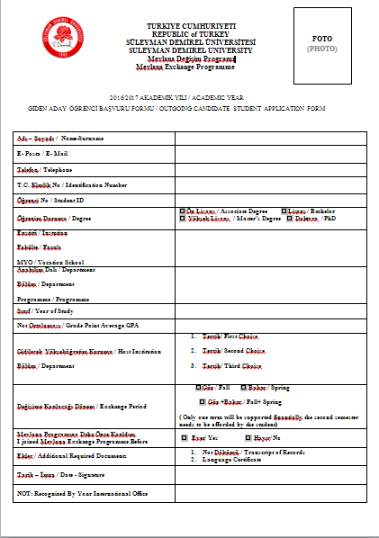

Slide 19
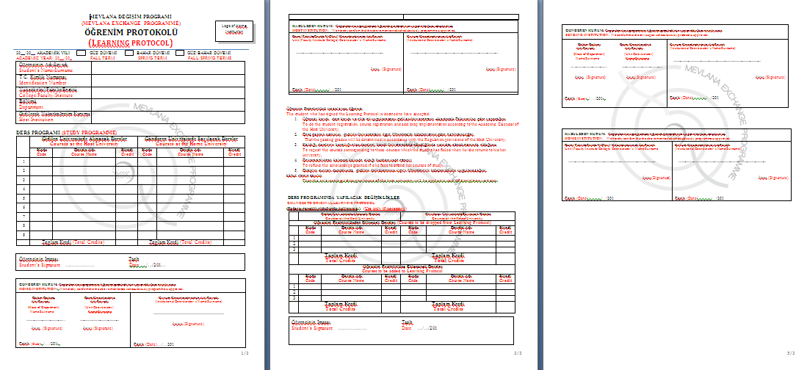

Slide 20
RESIDENT PERMIT
Incoming student should apply for his/her resident permit in a month after his/her arrival in Turkey.
Incoming students should bring their insurance documents with them. (The insurance should be valid in Turkey otherwise, they will pay approx. 600 TL for a new insurance.)

Slide 21
Documents Asked for Student Residence Permit
Online Application Form
Original copy and photocopy of the passport or travel document
Four Photos
Valid Health Insurance
Mevlana Student Certificate
Document showing your adress information
Residence Permit Card Fee Receipt
Income Statement

Slide 22
EDUCATIONAL EXPENCES
During the exchange mobility, the participant students must pay the required tuition fee to their home higher educational institute.
During the exchange mobility, the participant students don’t pay any tuition fee to the host university.

Slide 23
EXCHANGE OF ACADEMIC STAFF
Academic staff (professor, associate professor, assistant professor, lecturer) can participate to Mevlana Exchange Programme.
Research assistants could only participate to Mevlana Exchange Programme as a student not as an academic staff.
Academic staff should lecture at least 6 hours per a week.
Academic staff can participate Mevlana programme min. 14 days and max. 3 months.

Slide 24
DOCUMENTS FOR ACADEMIC STAFF
Candidate Academic Staff
Candidate Application form
CV, Annex
Certificate of Language
After The Confirmation
Academic Staff Mobility Programme
Letter of Acceptance
Academic Staff Declaration
Information Form
Before Leaving SDU
Academic Staff Final Report
Academic Staff Declaration of Attendance

Slide 25
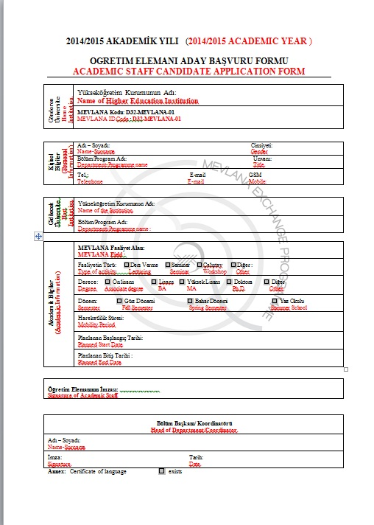

Slide 26
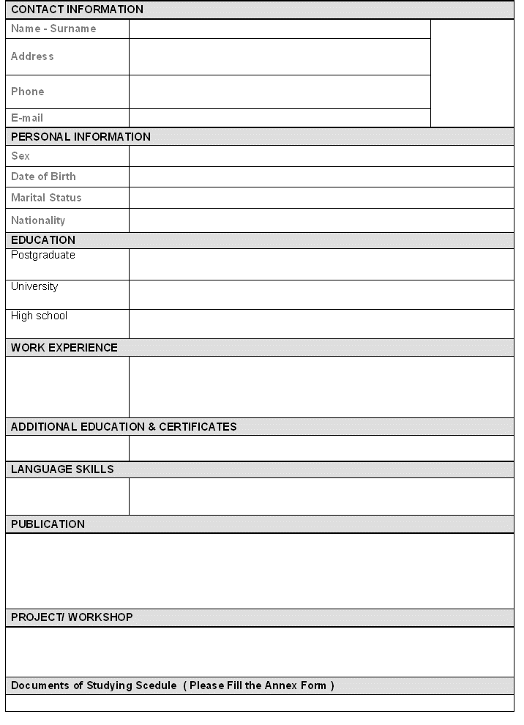
CV

Slide 27
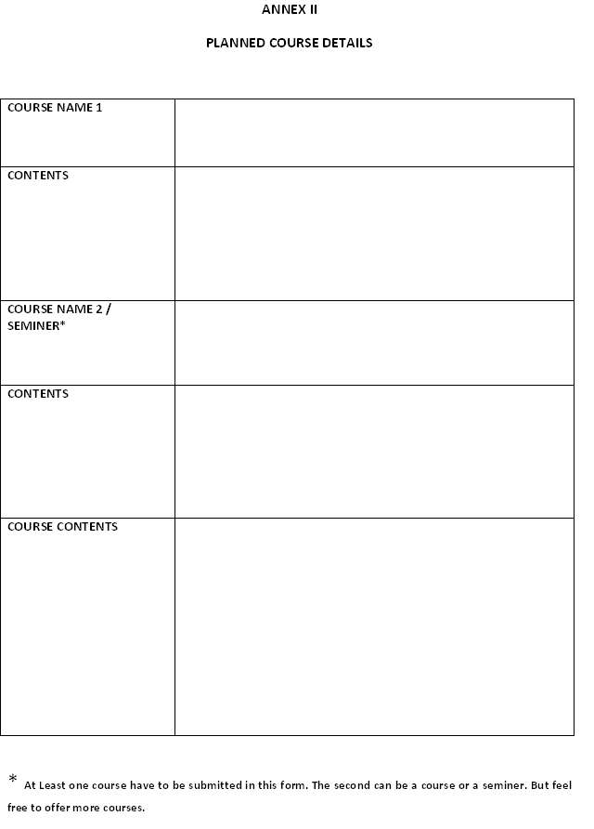

Slide 28
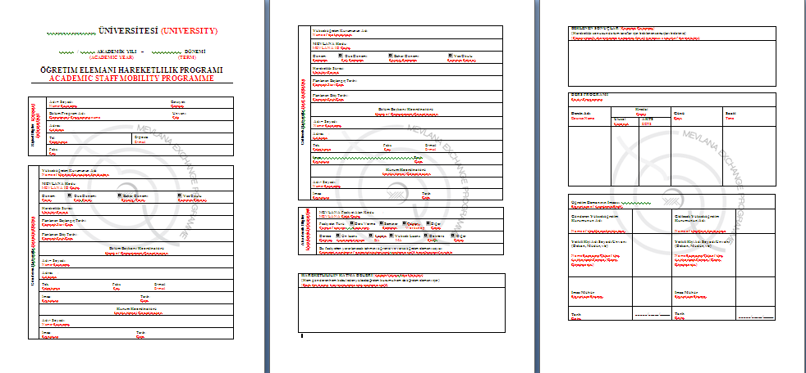

Slide 29
2016-2017 MEVLANA ACADEMIC CALENDAR
Application Dates | To be announced by The Council of Higher Education (Usually between February and March, each year)
Sending the assessment of incoming students and academic staff to SDU Mevlana Office | To be announced by The Council of Higher Education (Usually between February and March, each year)

Slide 30
DURATION OF EXCHANGE:
Student
Minimum 1, maximum 2 semesters (4 months with scholarship +1 semester without scholarship)
Couldn’t exceed one academic year
Academic Staff
Minimum 14 days
Maximum 3 months

Slide 31
Finantial Supports
For 2018-2019 Academic Year | PAYMENT (month/day) | TRAVEL PAYMENT (MAX)
INCOMING STUDENTS * | 1100 TL – 1300TL (per month) | -
INCOMING ACADEMIC STAFF | ~40 - 50 TL (per day) | 2500-4400TL
* REGIONS AND CONTINENTS | PAYMENT(MAX)
Europe, Asia-Pacific, Latin America, North America | 1.300,00 TL
Sahraaltı Afrika, Orta Asya | 1.200,00TL
South Caucasus, South Asia, Middle East and North Africa | 1.100,00 TL
80% of the scholarship is paid to students in a month after their arrival to SDU. The rest of the scholarship will be paid based on the ratio of total credits of the succeeded courses to the courses that the student is obliged to take. The scholarship includes only for four months.

Slide 32
PAYEMENT FOR ACADEMIC STAFF INCOMING (2018-2019)
Daily Wage
Professor | 50,00 TL
Associate Professor | 50,00TL
Assistant Professor | 50,00 TL
Lecturer | 40,00 TL

Slide 33
TRAVEL EXPENSES
COUNTRIES | PAYEMENT (MAX)
Azerbaijan | 2500 TL
Bosnia-Herzegovina | 2500 TL
Kazakstan | 3300 TL
Kyrgyztan | 3300 TL
Malaysia | 4400 TL
Indonesia | 4400 TL
Georgia | 2500 TL
Jordan | 2500 TL
Palestine | 2500 TL
Ukraine | 2500 TL
South Korea | 4400 TL
Tunis | 2500 TL

Slide 34
TRAVEL EXPENSES FOR REGIONS AND CONTINENTS
REGIONS AND CONTINENTS | PAYMENT(MAX)
Europe, Asia-Pacific, Latin America, North America | 1.300,00 TL
Sahraaltı Afrika, Orta Asya | 1.200,00TL
South Caucasus, South Asia, Middle East and North Africa | 1.100,00 TL

Slide 35
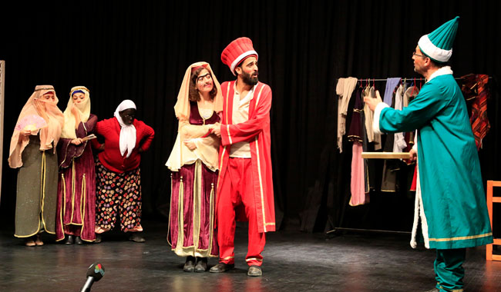
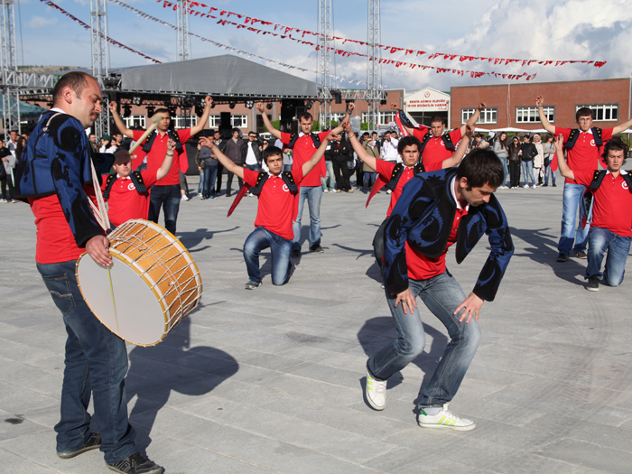
SOCIAL
ACTIVITIES

Slide 36
MEVLANA INCOMING STUDENTS

Slide 37
FOR MORE INFORMATION AND THE DOCUMENTS
Web Adres: http: mevlana.isparta.edu.tr
E-mail: mevlana@isparta.edu.tr
Phone: 00 90 246 211 82 76 – 77

